Slide 1
CONFLICT
The essence of conflict seems to be disagreement, contradiction, or incompatibility. Thus, CONFLICT refers to any situation in which there are incompatible Goals, Cognitions, or Emotions within or between individuals or groups. Conflict might escalate and nonproductive results, or conflict can be beneficially resolved and lead to quality fin products.
Therefore, learning to manage conflict is integral to a high-performance team. Although very few people go looking for conflict, more often than not, conflict results because of miscommunication between people with regards to their needs, ideas, benefits, values or goals.
Conflict management is the principle that all conflicts cannot necessarily be resolved, but learning how to manage conflicts can decrease the odds of nonproductive escalation.

Slide 2
Conflict management involves acquiring skills related to conflict resolution, self awareness about conflict modes, conflict communication skills, and establishing a structure for management of conflict in your environment.
Necessity of Conflict Management:
Listening, oral communication, interpersonal communication, and teamwork rank near the top of skills that employers seek in their new hires. When you learn to effectively manage and resolve conflicts with others, then more opportunities for successful team memberships are available to you.

Slide 3
Most people do not resolved conflicts because they either have a faulty skill set and/or because they do not know the organization's policy on conflict management. All team members need to know their conflict styles, conflict intervention methods, and strategies for conflict skill improvement.

Slide 4
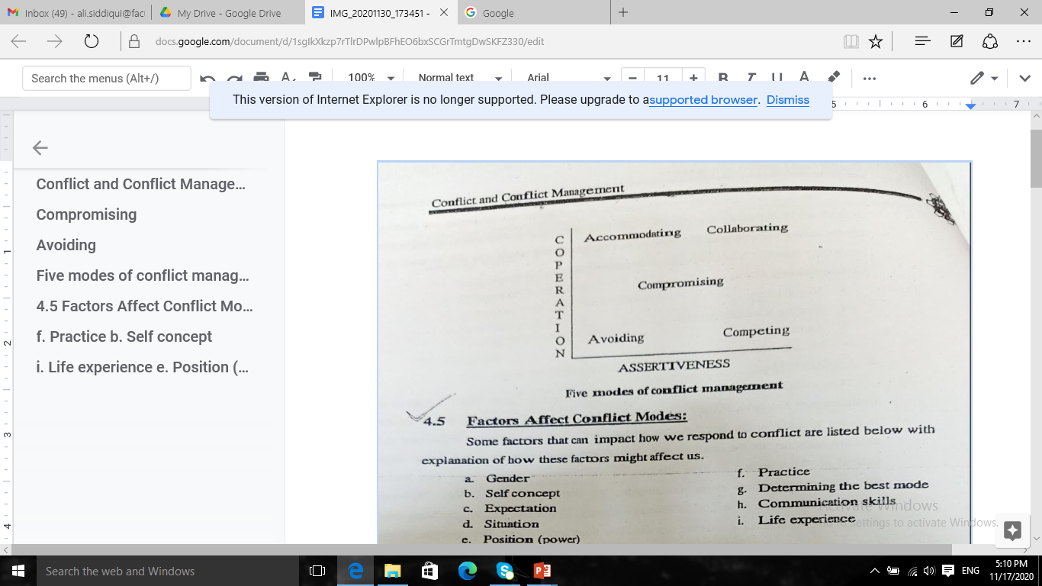
Modes of Conflict:
All people can benefit, both personally and professionally, from learning conflict management skills. Typically we respond to conflict by using one of five modes:
Competing
Avoiding
Accommodating
Compromising
• Collaborating

Slide 5
Each of these modes can be characterized by two scales: assertiveness and cooperation. None of these modes is wrong to use, but there are right and wrong times to use each. The information may help each team member to characterize his/her model for conflict management.
The Thomas-Kilman Conflict Mode Instrument (TKI) is a widely used assessment for determining conflict modes. The assessment takes less than fifteen minutes to complete and yield conflict scores in the areas of competing, avoiding, accommodating, compromising, and collaborating

Slide 6
1. Competing:
The competing conflict mode is high assertiveness and low cooperation. Times when the competing mode is appropriate are when quick action needs to be taken, when unpopular decisions need to be made, when vital issues must be handled, or when one is protecting self-interests.
Competing skills:
• Arguing or debating
• Using rank or influence
• Asserting your opinions or feelings
• Standing your ground
• Stating your position clearly

Slide 7
2. Avoiding:
The avoiding mode is low assertiveness and low cooperation. Many times people will avoid conflicts out of fear of engaging in a conflict or because they do not have confidence in their conflict management skills. Times when the avoiding mode is appropriate are when you have issues of low importance, to reduce tensions, to buy some time, or when you are in a position of lower power.
Avoiding skills:
Ability to withdraw
Ability to sidestep issues
Ability to resolved things unresolved
Sense of timing

Slide 8
3. Accommodating:
The accommodating conflict mode is low assertiveness and high cooperation. Times when the accommodating mode is appropriate are to show reasonableness, develop performance, create good will, or keep peace. Some people use the accommodating mode when the issue or outcome is of law importance to them
Accommodating mode can be problematic when one uses the mode to "keep a calculation" or to be a martyr. For example, if you keep a list of the numbers of times you have accommodated some one and then you expect that person to realize, without your communicating to the person, that he/she should now accommodate you.

Slide 9
Accommodating skills
Forgetting your desires
Selfness
Ability to yield
Obeying orders
4. Compromising:
The compromising mode is moderate assertiveness and moderate cooperation. Some people define compromise as “giving up more than you want", while others see compromise as both parties winning.

Slide 10
Times when the compromising mode is appropriate are when you are dealing with issues of moderate importance, when you have equal power status, or when you have a strong commitment for resolution
Compromising mode can also be used as a temporary solution when there are time constraints.
Compromising skills:
Negotiating
Finding a middle ground
Assessing value
Making concessions

Slide 11
5. Collaborating:
The collaborating mode is a high assertiveness and high cooperation.
has been defined as "putting an idea on top of an idea, in order to achieve the best solution to conflict". The best solution is defined as a creative Solution to the conflict that would not have been generated by a single individual. With such a positive outcome for collaboration some people will profess that the collaboration mode is always the conflict mode to use.
However, collaborating takes a great deal of time and energy. Therefore, the collaborating mode should be used when the conflict warrants the time and energy. For example, if your team is establishing initial parameters for how to work effectively together, then using the collaborating mode could be quite useful. On the other hand, if your team is in conflict about where to go to lunch today, the time and energy necessary to collaboratively resolve the conflict is probably not beneficial.

Slide 12
Times when the collaborative mode is appropriate are when the conflict is important to the people who are constructing an integrative solution, when the issues are too important to compromise, when merging perspectives, when gaining commitment, when improving relationships, or when learning.
Collaborative skills:
Active listening
Non-threatening confrontation
Identifying anxieties/worries (concerns)
Analyzing input

Slide 14
Factors Affect Conflict Modes:
Some factors that can impact how we respond to conflict are listed below with explanation of how these factors might affect us.
a. Gender
b. Self concept
C. Expectation
d. Situation
e. Position (power)
f. Practice
g. Determining the best mode
h. Communication skills
i. Life experience

Slide 15
a. Gender:
Some of us were socialized to use particular conflict modes because of our gender. For example, some males, because they are male, were taught "always stand up to someone, and, if you have to fight, then fight". If one was socialized this way he will be more likely to use assertive conflict modes versus using cooperative modes.
b. Self-concept:
How we think and feel about ourselves affect how we approach conflict. Do we think our thoughts, feelings, and opinions are worth being heard by the person with whom we are in conflict?
c. Expectations:
Do we believe the other person or our team wants to resolve the conflict?
d. Situation:
Where is the conflict occurring, do we know the person we are in conflict with, and is the conflict personal or professional?

Slide 16
e. Position (Power):
What is our power status relationship, (that is, person with whom we are in conflict?
f. Practice:
Practice involves being able to use all five conflict modes effectively, It
being able to determine what conflict would be most effective to resolve the conflict, and the ability to change modes as necessary while engaged in conflict.
g. Determining the best mode:
Through knowledge about conflict and through practice we develop a “conflict management understanding and can, with ease and limited energy determine what determine what conflict mode to use with the particular person with whom we are in conflict use with the particular person with whom we are in conflict.

Slide 17
h. Communication skills:
The essence of conflict resolution and conflict management is the ability to communicate effectively. People who have and use effective communication will resolve their conflicts with greater ease and success.
Life experiences:
As mentioned earlier, we often practice conflict modes we saw our primary caretakers use unless we have made a conscious choice as adults to change or adopt our conflict styles. Some of us had great role models teach us to manage our conflicts and others of us had less-than- great role models. Our life experiences, both personal and professional, taught us to frame conflict as either something positive that can be worked through or some thing negative to be avoided and ignored at all costs.

Slide 18
Selecting how we manage our conflict, why we manage the conflict the way we do, and thinking about the value of engaging in conflicts with others is important. With better understanding we can make informed choices about how we engaged in conflict and when we will engage in conflict The next section provides points for us to consider when determining if we will enter into a conflict situation or not.

Slide 19
Selection of Conflict Management Style:
There are times when we have a choice to engage in or avoid a conflict. The following six variables should be considered when you decide whether to engage in conflict.
1. How invested in the Professional relationship are you?
The importance of the working/personal relationship often dictates whether will engage in a conflict. If you value the person and/or relationship, going through the process of conflict resolution is important.
2. How important is the issue to you?
Even if the relationship is not of great value to you, one most often engage in conflict if the issue is important to you. For example, if the issue is a belief, value, or regulation that you believe in or hired to enforce, then engaging in the conflict is necessary. If the relationship and the issue are both important to you, there is an even more compelling reason to engage in the conflict.

Slide 20
3. Do you have the energy for the conflict?
Many of us say, 'There is not time to do all that I want to do in a day". Often the issue is not how much time is available but how much energy we have for what we need to do. Even in a track meet, runners are given recovery time before they have to run another race. Energy, not time, is being managed in these situations.
4. Are you aware of the potential consequences?
Prior to engaging in a conflict, thinking about anticipated consequences from engaging in a conflict is wise. For example, there may be a risk for your safety, a risk for job loss, or an opportunity for a better working relationship. Many times people will engage in conflict and then be shocked by outcome or consequences of engaging in conflict. Thoughtful reflection about consequences, both positive and negative, is useful before engaging in or avoiding a conflict.

Slide 21
5. Are you ready for the consequences?
After analyzing potential consequences, whether you are prepared for the consequences of engaging in a conflict, for example, one employee anticipated job loss if he continued to engage in the conflict he was having with his boss over a particular issue.
After careful consideration, the employee thought and believed strongly enough about the issue that he did engage in the conflict with his boss. His annual contract was not renewed for the upcoming year. Because this individual had thought through the consequences of engaging in the conflict, he was prepared to be without a job for a while and able to financially and emotionally plan for this outcome. Most consequences of engaging in conflict are not this severe, but this example illustrates the value of thinking through consequences.

